Slide 1
Crop Recommendation System
Using IoE
Team Member Name:
Burhanuddin Dilshad (Roll No. 07)
Viraj Gholap (Roll No. 10)
Guided By:
Mr. Uday Rote
Department of Information Technology

Slide 2
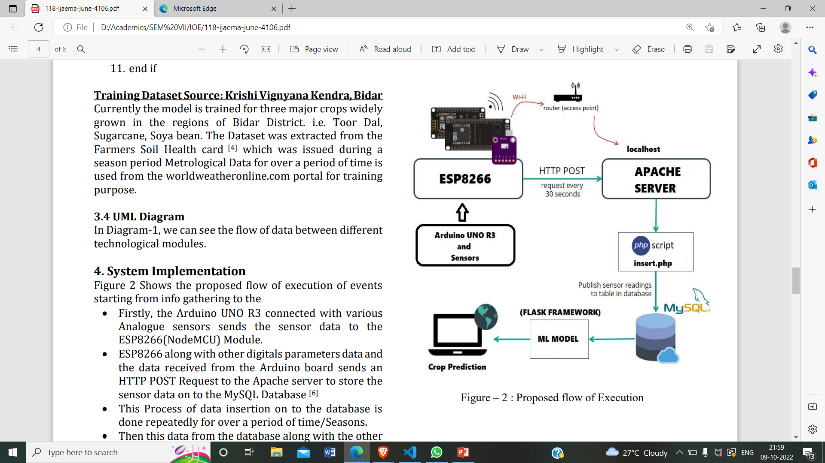
Communication Architecture of Project:

Slide 3
List the Related Protocols:
IEEE 802.11(wi-fi)
HTTP
MQTT
ZigBee
Bluetooth

Slide 4
Analysis of Protocols
IEEE 802.11 : Wifi Protocol. Provides Internet Connection. Connects Node MCU to Apache Server.
HTTP: Process large amount of data. Transfers multimedia files. E.g. text, images, sound, video, etc.
MQTT: Messaging Query Telemetry Transport. Messaging Protocol. Sub/Pub Model. Broker based.
ZigBee: Zigbee is a standards-based wireless technology developed to enable low-cost, low-power wireless machine-to-machine and internet of things networks.
Bluetooth: 2.4 GHz frequency. Bluetooth is a standardized protocol for sending and receiving data via a 2.4GHz wireless link. It's a secure protocol, and it's perfect for short-range, low-power, low-cost, wireless transmissions between electronic devices.

Slide 5
Wi-Fi And HTTP
Justification of Protocols:
Wifi is used to connect to the server.
HTTP is used to send data from Node MCU to Apache server using POST request.

Slide 6
Benefits: 1. Suggest a very suitable crop to be cultivated. 2. Maximize productivity in agriculture, reduce soil degradation in cultivated fields, and reduce fertilizer use in crop production. 3. Prediction is automated by fetching the data from SQL database and it is fed into a machine learning model. Drawbacks: 1. This is done only for a land of less area. 2. Not suitable for commercialization.
Benefits and Limitations

Slide 7
1. Helps in Predicting an efficient crop which can be grown in a particular field area which results in a good crop yield, high Income eliminating weather risks. 2. Factors are considered from farmers’ perspective. 3. This Data can also be used for various Educational or Research Purposes.. 4. An algorithm can be implemented to predict the one factor using another two factors. (Example – predicting the soil pH level from soil moisture and sunlight)
Conclusion :

